Slide 1
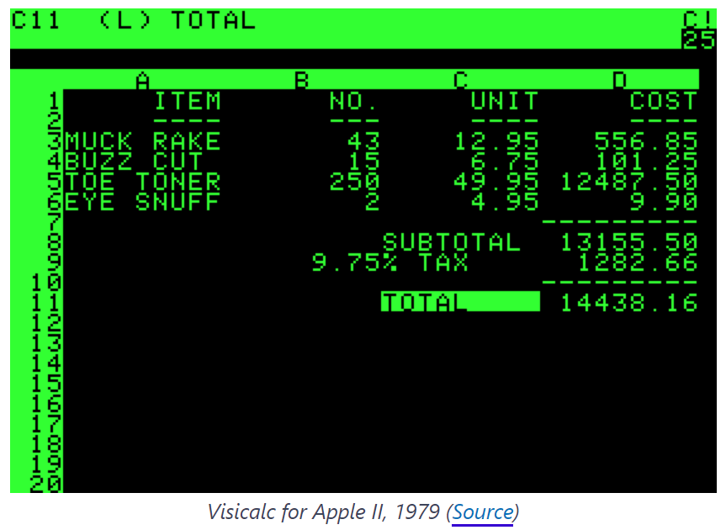
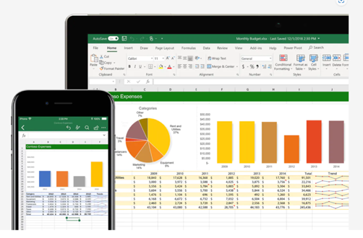
MS Excel

Slide 2

About me
Daniil Bogomazov
Directory of Analytics | Crowley Maritime
Data Modeling and Engineering, Business Analytics, ERP/HCM systems
Use Microsoft stack of tools including SQL, MS Power Platform
www.crowley.com
danil.bogomazov@crowley.com
bogomazovdaniil@gmail.com
https://www.linkedin.com/in/daniil-bogomazov-4882a91b/

Slide 3
Topics
MS Excel brief history
Most popular spreadsheet alternatives
Most interesting Excel features (per my opinion):
Dynamic Array Formulas
New Excel syntax and LAMBDA function
Power Query
Power Pivot
Excel Automation (Office Scripts)

Slide 4
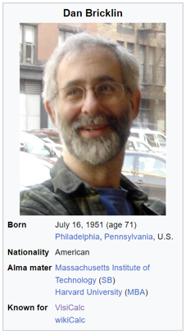
Excel History
The first spreadsheet program was VisiCalc, written for the Apple II computer in 1979 by Dan Bricklin, grand father of modern spreadsheet - VisiCalc - http://www.bricklin.com/
It was so popular that people were ready to buy Apple II for $2,000 just to run VisiCalc – by the way, the day VisiCalc was launched (October 17) is considered Spreadsheet Day.
https://spreadsheetdaddy.com/blog/excel-facts

Slide 5
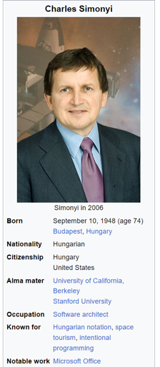
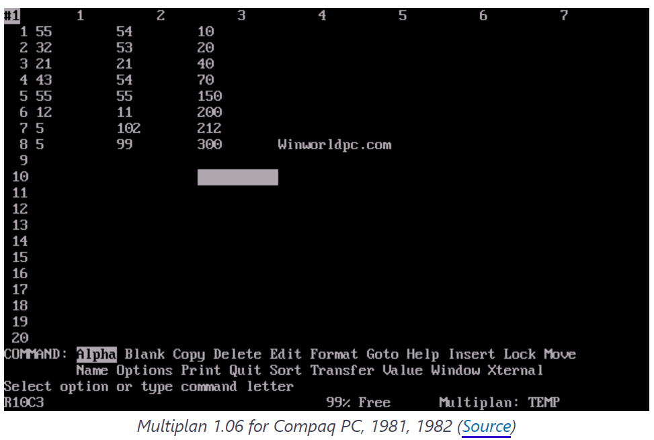
Early Microsoft employee Charles Simonyi is the man behind some of the company's most successful software, including Word and Excel. Multiplan was original name

Slide 6
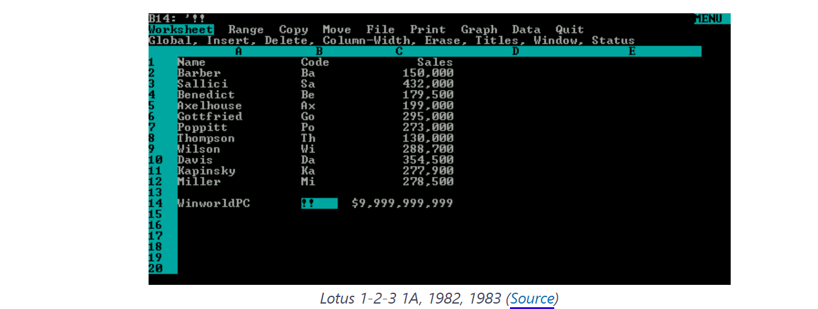
The main competitor of Multiplan was the program called Lotus 1-2-3, the first “killer application” of the IBM PC. This application was the industry standard in 80x

Slide 7
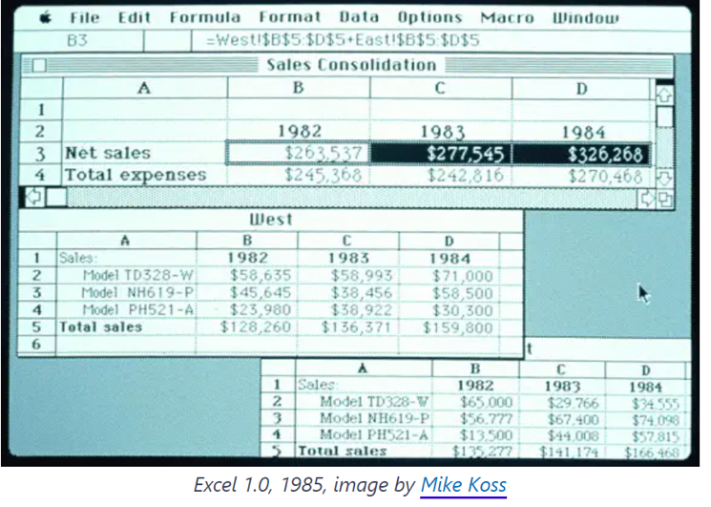
To outsell it, Microsoft decided to bank on the user-friendly interface and the possibility to change spreadsheet design. Thus, the first version of Excel for the Macintosh was released on September 30, 1985, and this day marked the gradual decline of Lotus 1-2-3. Ironically, IBM stopped supporting Lotus 1-2-3 exactly on September 30, 2014.

Slide 8
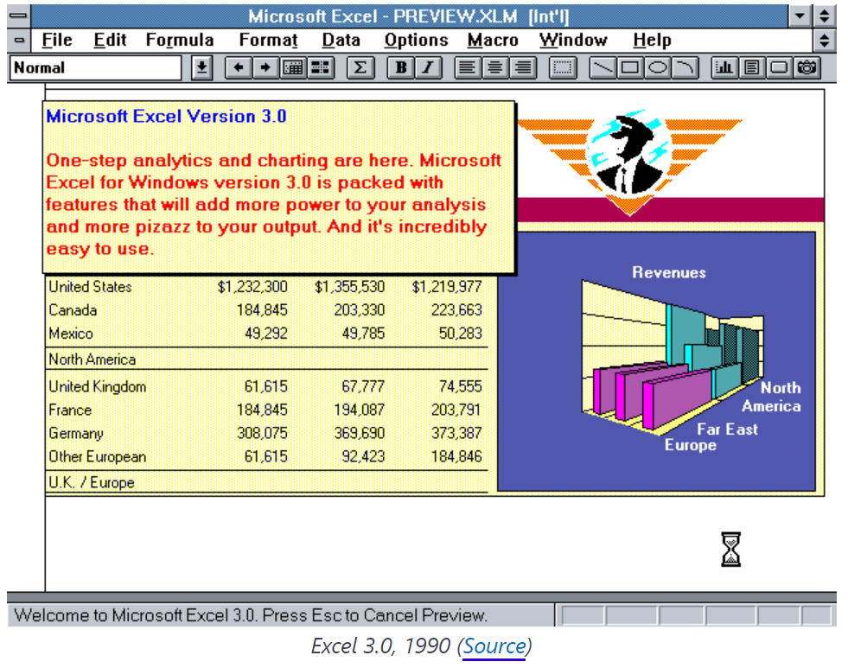
Toolbar was introduced in 1990. Few people know that such a simple and seamless feature that can be found virtually in every software product today was pioneered by Excel 3.0, the first application to ever use a toolbar.

Slide 9

Excel 2007 was major update with addition of new ribbon and increase of rows (1,048,576 ) and columns (16,384)
Excel 2013 included Power Pivot (predecessor of Power BI)
Excel 2016 included Power Query Integration
Since 2019 Microsoft no longer releases
discrete versions rather then part of Windows
Update. Major update was dynamic array
formulas (formula returns range not just single
value) in response to Google Sheets.
Three flavors of Excel:
MS Excel Desktop
MS Excel for Web
MS Excel for Mobile devices

Slide 10
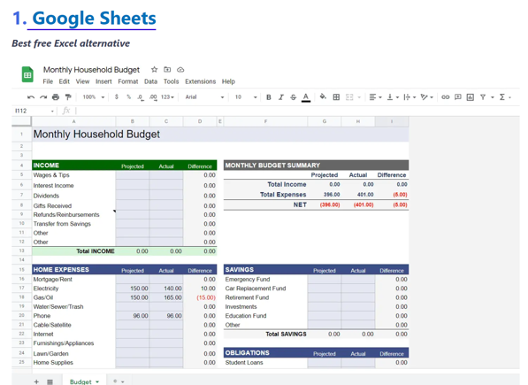

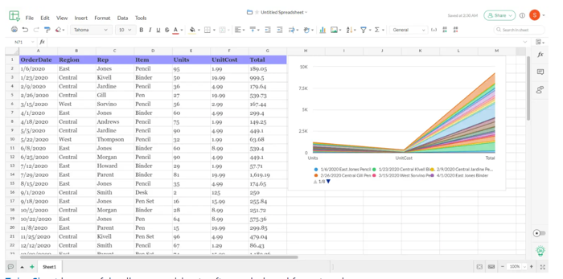
Excel MOST POPULAR ALTERNATIVES
https://www.youtube.com/watch?v=n2DxXffRxBM - Google Sheets BEATS Excel with THESE 10 Features!
https://www.youtube.com/watch?v=yXMo9sj0Y2Y- Excel BEATS Google Sheets with THESE 10 Features!
https://spreadsheetdaddy.com/best-excel-alternatives

Slide 11
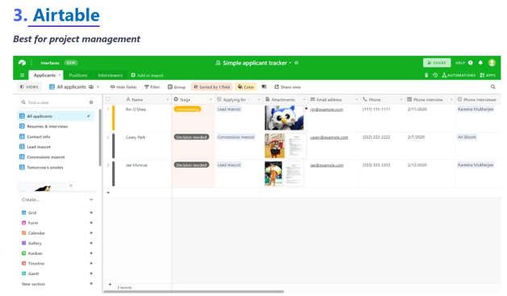
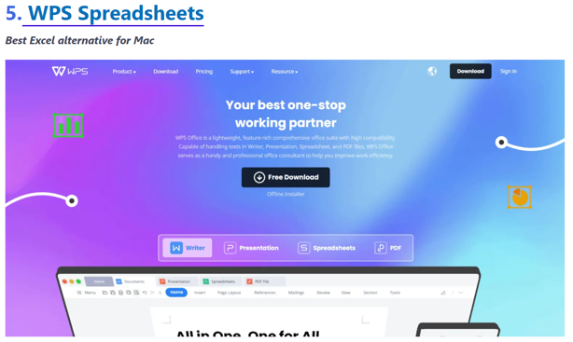
https://spreadsheetdaddy.com/best-excel-alternatives

Slide 12
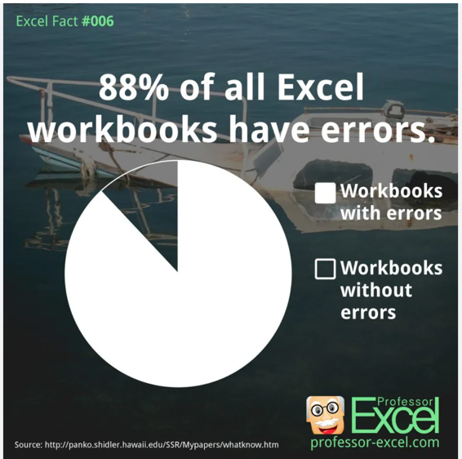
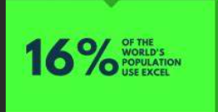

Slide 13
What is Excel good for and why it’s so popular
Excel is good for business data analysis, data storage, ad hock reporting, it’s probably the most popular “database”
Easy to use because of the two-dimensional grid concept of rows and columns
Microsoft bundles MS Excel it as part of Microsoft Office 365 and fully integrated with other office applications
Excel dates can only be in the range from 1–1–1900 to 31–12–9999 that’s why make analysis hard outside this range

Slide 14
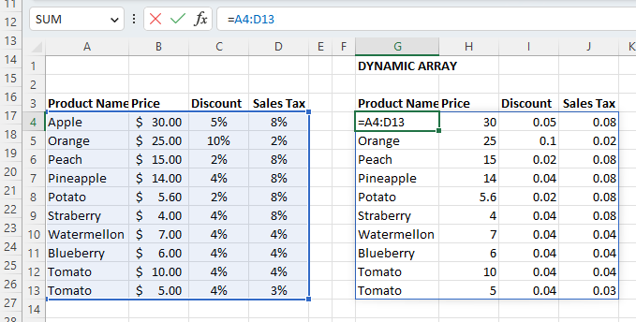
Dynamic Array Formulas
Excel formulas that can return set of values (array) of variable size are called dynamic array formulas.
FILTER function
RANDARRAY function
SEQUENCE function
SORT function
SORTBY function
UNIQUE function
#SPILL! errors in Excel

Slide 15
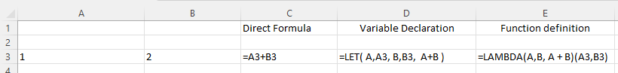
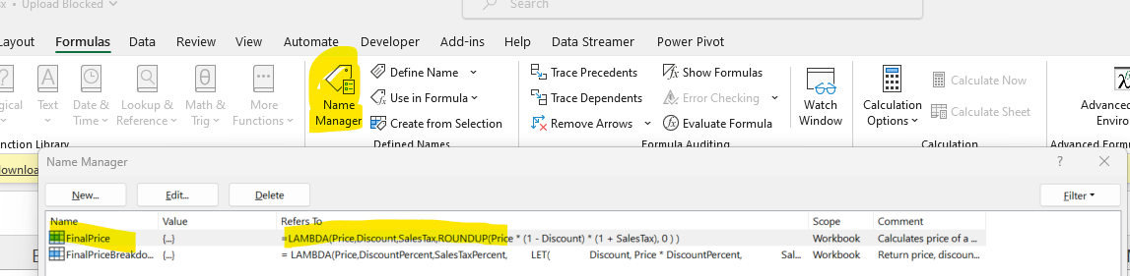
New Excel syntax and LAMBDA function
LET function allows to break down complex formulas into intermediate steps using variables LAMBDA is designed to create custom functions that can be called by user-friendly names and reused throughout a workbook. Simply put, you can now take any existing formula, whatever complex it is, wrap it up in LAMBDA, and give it any name you like. Functions are defined in Name Manager

Slide 16
Excel Formula Formatting
UNFORMATTED WITH NO VARIABLES
CHOOSE({1,2,3,4,5}, B13, - B13*C13, B13*(1-C13)*D13,ROUNDUP(B13*(1-C13)*(1+D13),0) - B13*(1-C13)*(1+D13), ROUNDUP(B13*(1-C13)*(1+D13),0) )
UNFORMATTED BUT WITH USE OF VARIABLES
FinalPriceBreakdown = LAMBDA(Price,DiscountPercent,SalesTaxPercent, LET( Discount, Price * DiscountPercent, SalesTax, (Price - Discount) * SalesTaxPercent, TotalPrice, Price - Discount + SalesTax, Rounding, ROUNDUP(TotalPrice,0) - TotalPrice, FinalPrice, TotalPrice + Rounding, CHOOSE({1,2,3,4,5}, Price, - Discount, SalesTax, Rounding,FinalPrice) )
MANNUALY FORMATTED (Excel currently doesn’t format)
FinalPriceBreakdown = LAMBDA(Price,DiscountPercent,SalesTaxPercent,
LET(
Discount, Price * DiscountPercent,
SalesTax, (Price - Discount) * SalesTaxPercent,
TotalPrice, Price - Discount + SalesTax,
Rounding, ROUNDUP(TotalPrice,0) - TotalPrice,
FinalPrice, TotalPrice + Rounding,
CHOOSE({1,2,3,4,5}, Price, - Discount, SalesTax, Rounding, FinalPrice)
)
)
Function parameters
Variable definition
Return argument

Slide 17
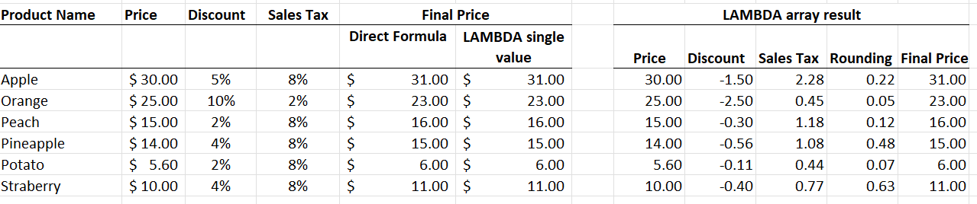
New Excel syntax and LAMBDA function demo
Additional Functions used in conjunction with LAMBDA function:
MAP function
REDUCE function
SCAN function
MAKEARRAY function
BYROW function
ISOMITTED function

Slide 18
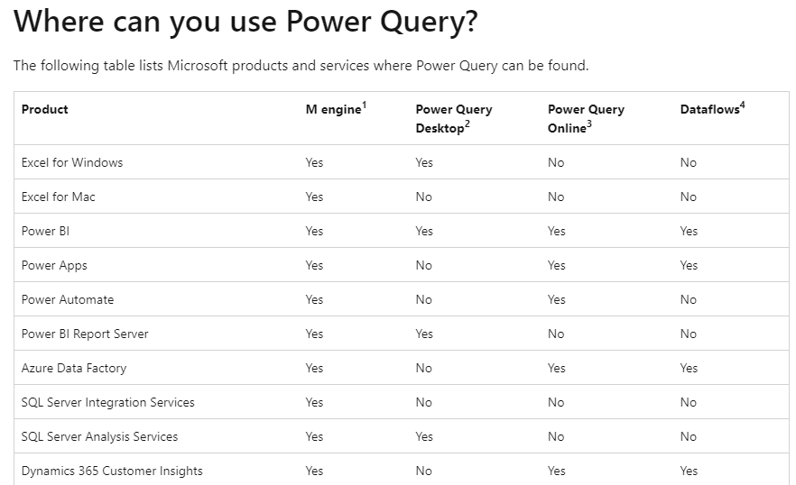
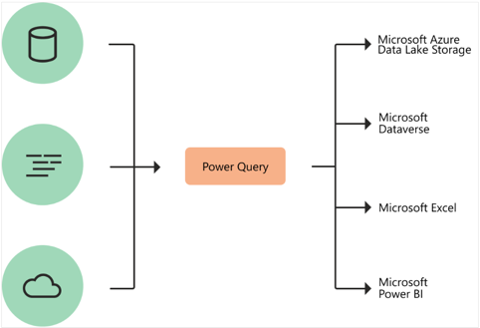
Power Query (M language)
Power Query is a data transformation and data preparation engine. Power Query comes with a graphical interface for getting data from sources and a Power Query Editor for applying transformations. Because the engine is available in many products and services, the destination where the data will be stored depends on where Power Query was used. Using Power Query, you can perform the extract, transform, and load (ETL) processing of data.

Slide 19
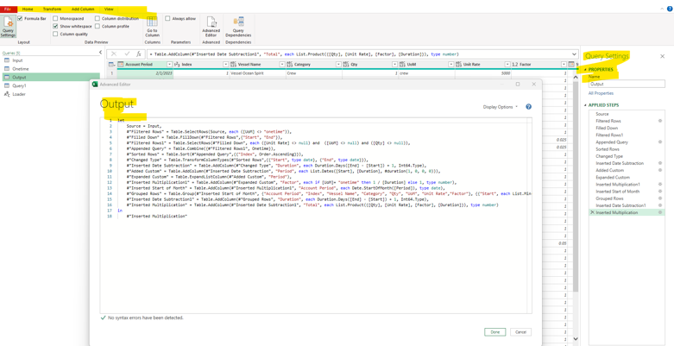
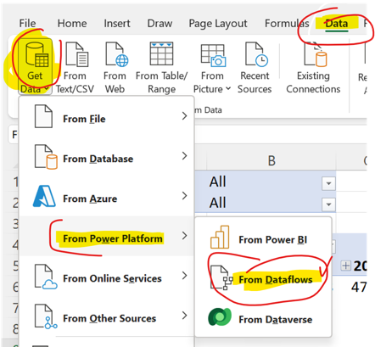
Power Query Demo

Slide 20
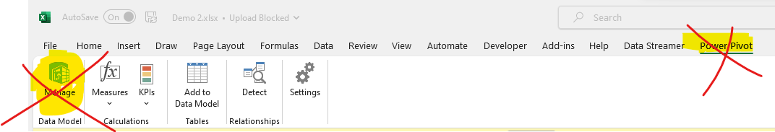
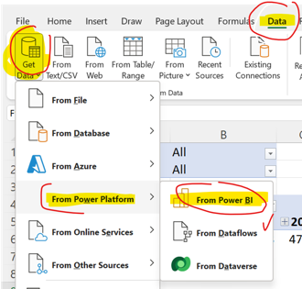
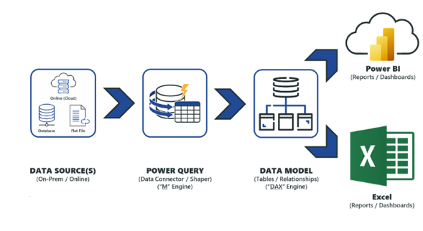
Excel as a client tool for Power BI
Excel currently supports Power Pivot (predecessor of Power BI), but Microsoft strategically invests into Power BI Service that’s why it’s recommended to build semantic models in Power BI if possible and use Excel as one of possible clients' tools. Especially good for ad-hock reporting and analysis, ease of data retrieval from the database
Multi – Dimensional eXpressions (MDX)
Dynamic Expression Language (DAX)

Slide 21
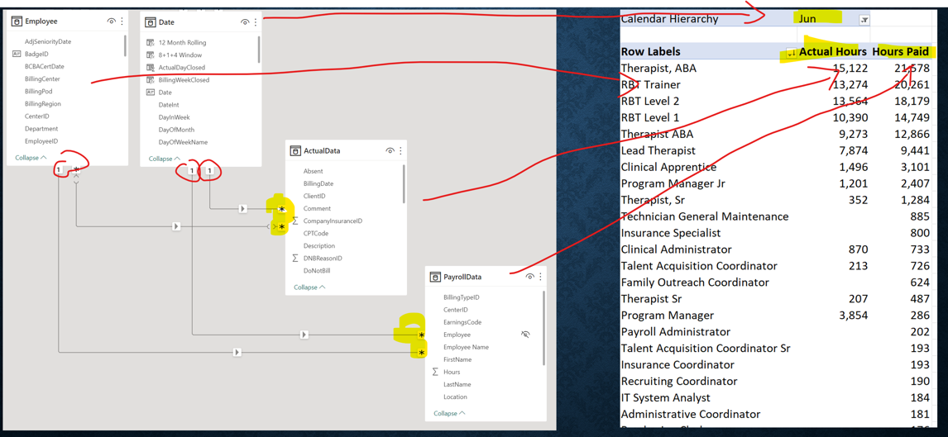

Slide 22
Methods to consume BI models in Excel
Pivot Table
Charts
Tables
CUBE formulas

Slide 23
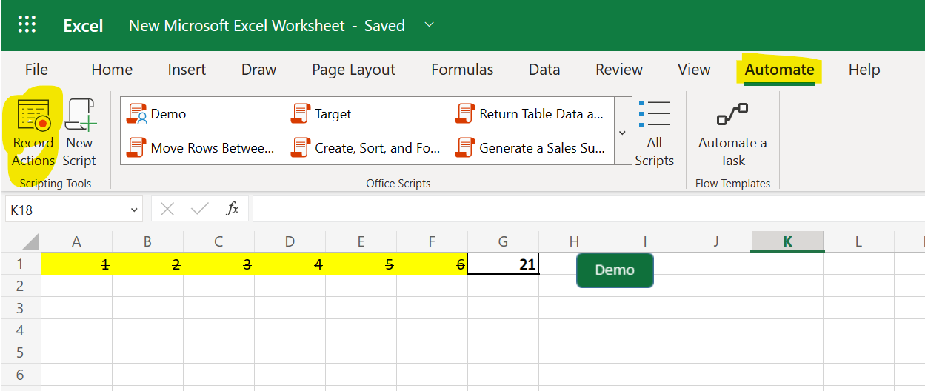
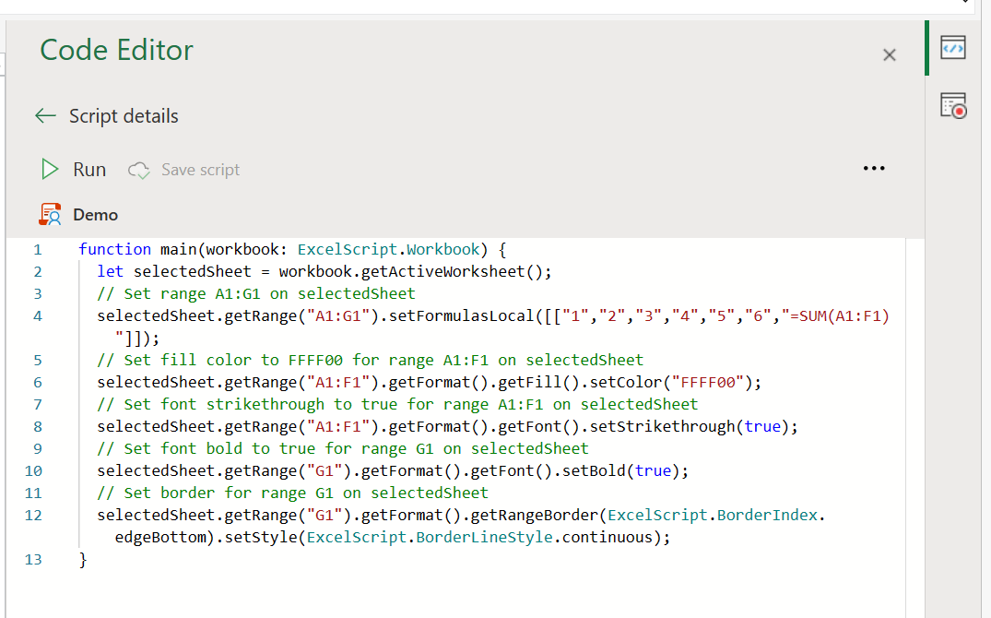
Excel Automation using Office Scripts
TypeScript (subset of JavaScript)
Basic scripts for Office Scripts in Excel - Office Scripts | Microsoft Learn

Slide 24
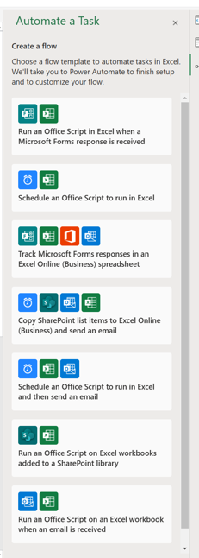
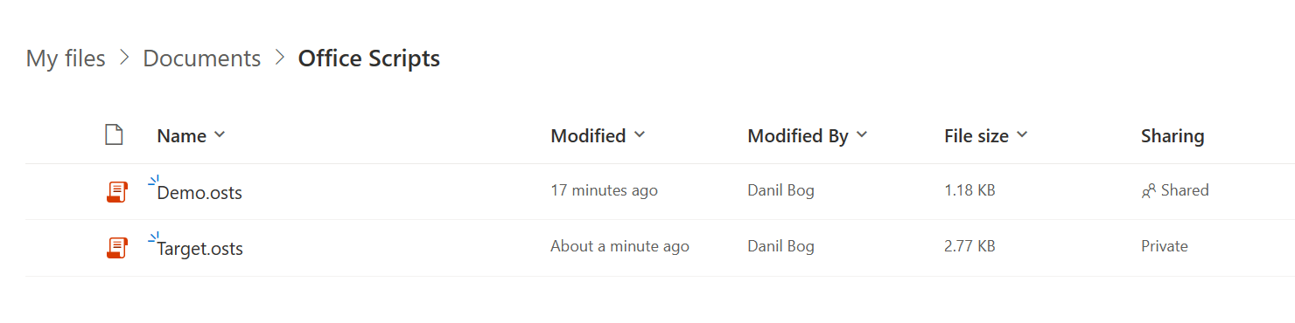

Slide 25
MS Excel Resources
70 Best Excel Blogs and Websites .. https://blog.feedspot.com/excel_blogs/
Best YouTube Channels To Learn Excel (For Absolute Beginners in 2023) .. https://www.websiterating.com/productivity/best-youtube-channels-to-learn-excel/

